Slide 1
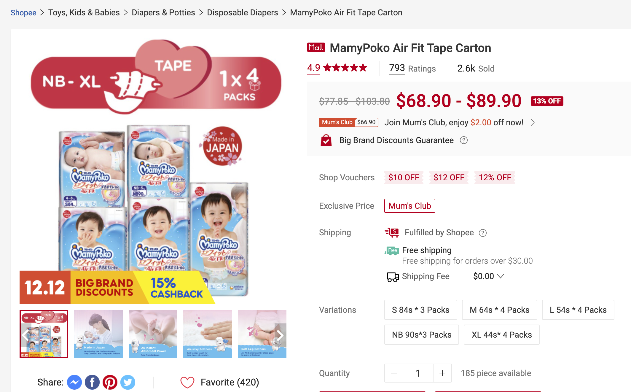
CONSENSYS
+ BREADCRUMB, ID, DATE OF SCRAPE, URL
Capture
CONVERT TO UNITS E.G. K = *1000
LOWEST PRICE & HIGHEST PRICE
Count of images
or retrieve them
Consensys.world
© CONSENSYS

Slide 2
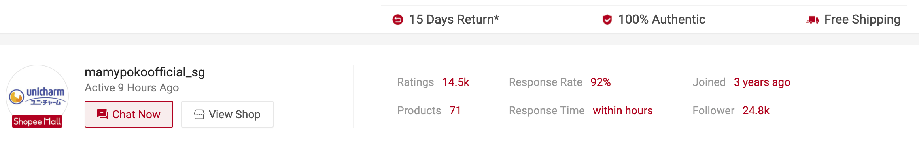
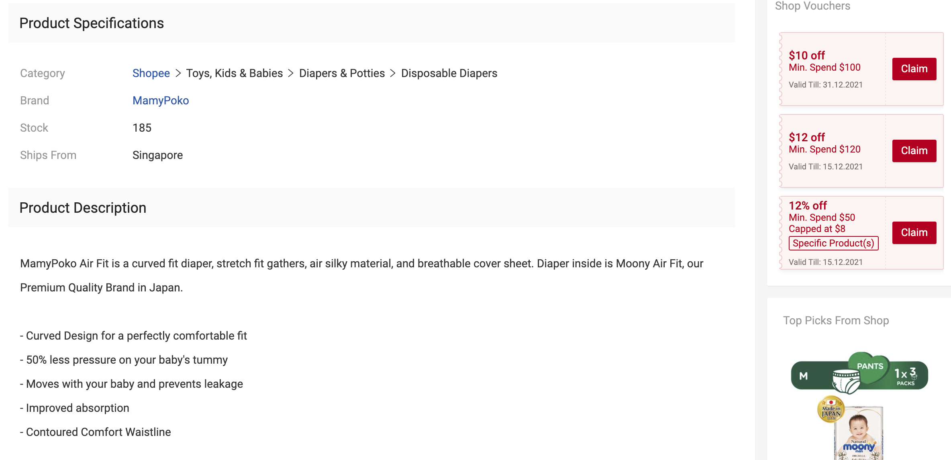
CONSENSYS
Capture
SELLER METRICS
PRODUCT DETAILS FULL TEXT
Consensys.world
© CONSENSYS

Slide 3
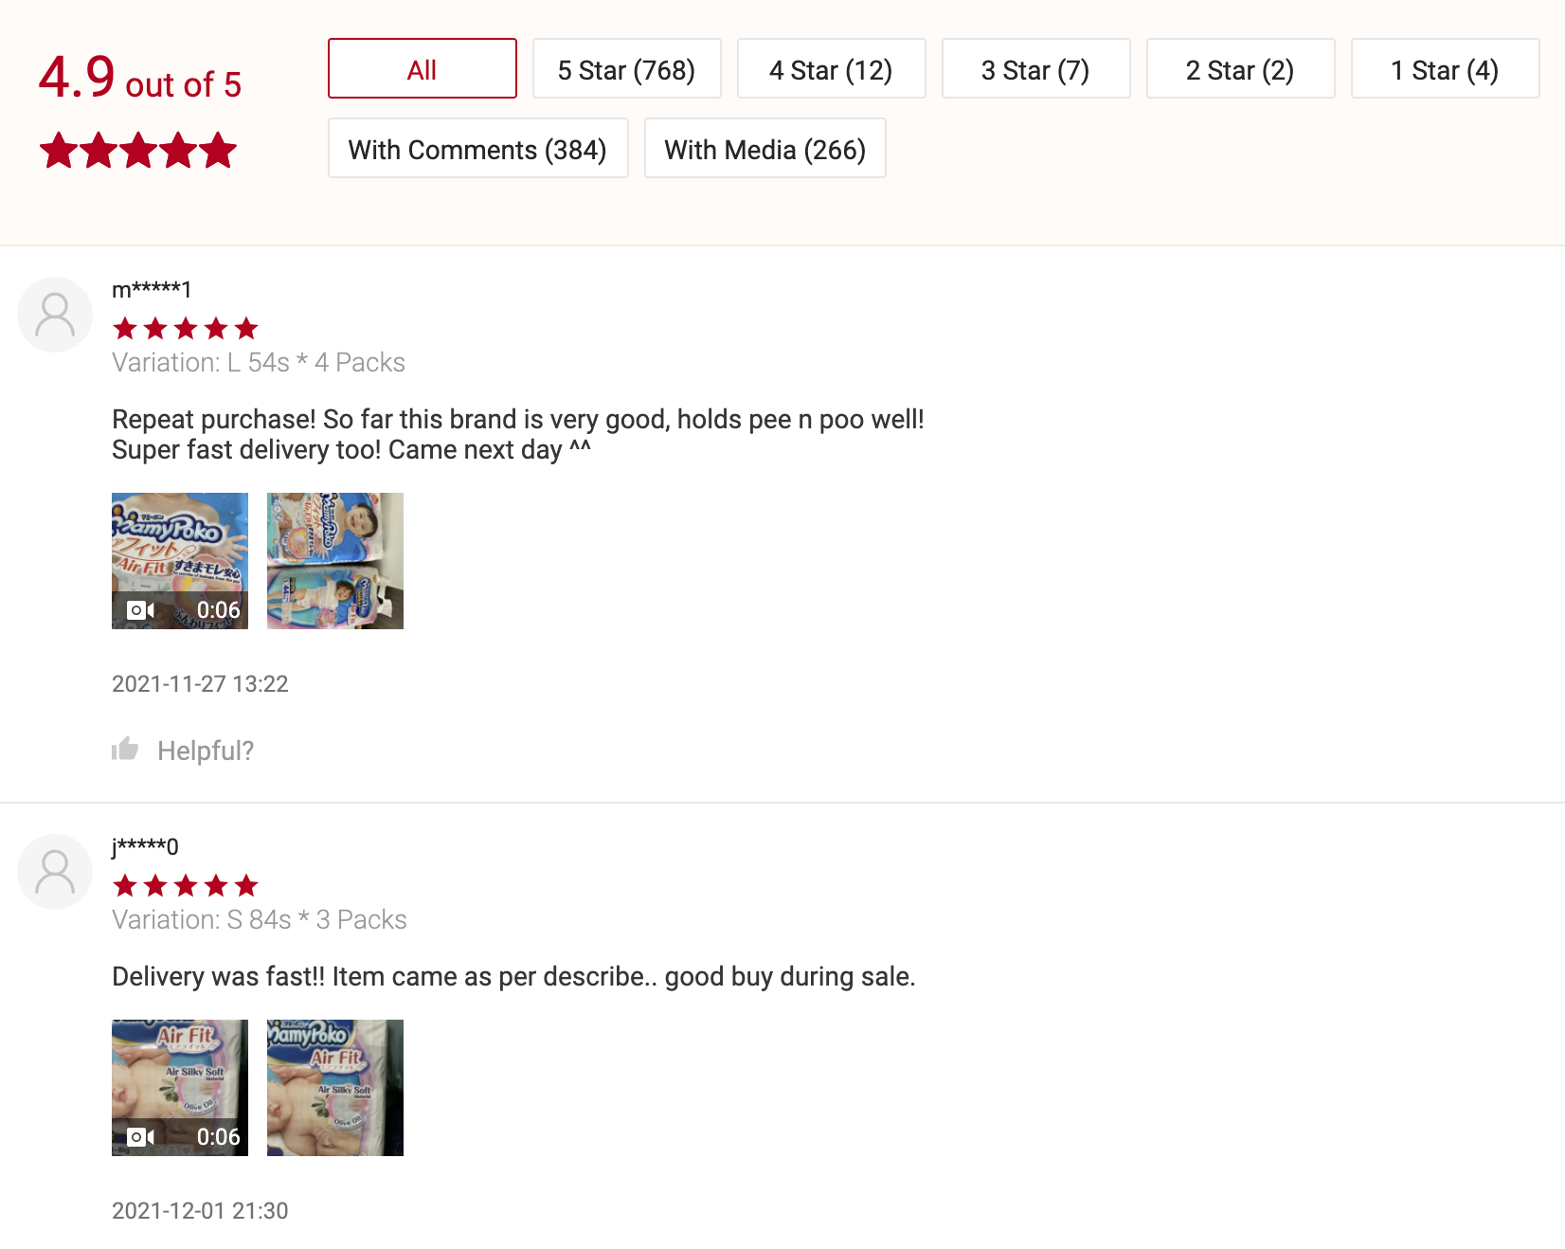
CONSENSYS
Capture
TEXT ORIGINAL AND A VERY GOOD TRANSLATION TO ENGLISH
ALL REVIEWS
Consensys.world
© CONSENSYS

Slide 4
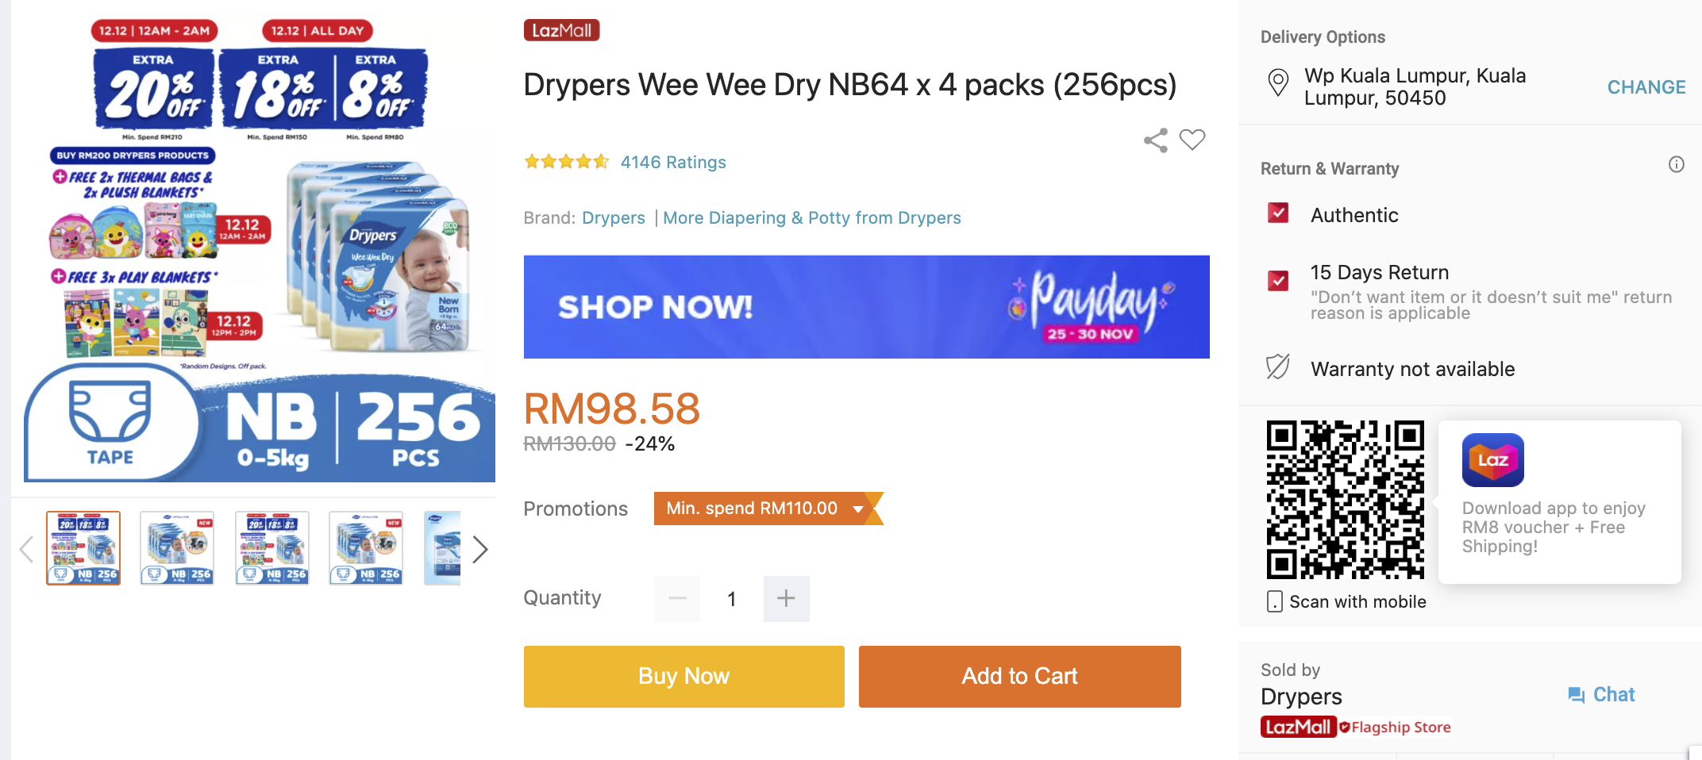
CONSENSYS
Capture
+ BREADCRUMB, ID, DATE OF SCRAPE, URL
Count of images
or retrieve them
Consensys.world
© CONSENSYS

Slide 5
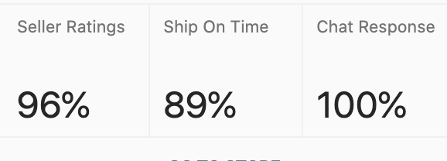
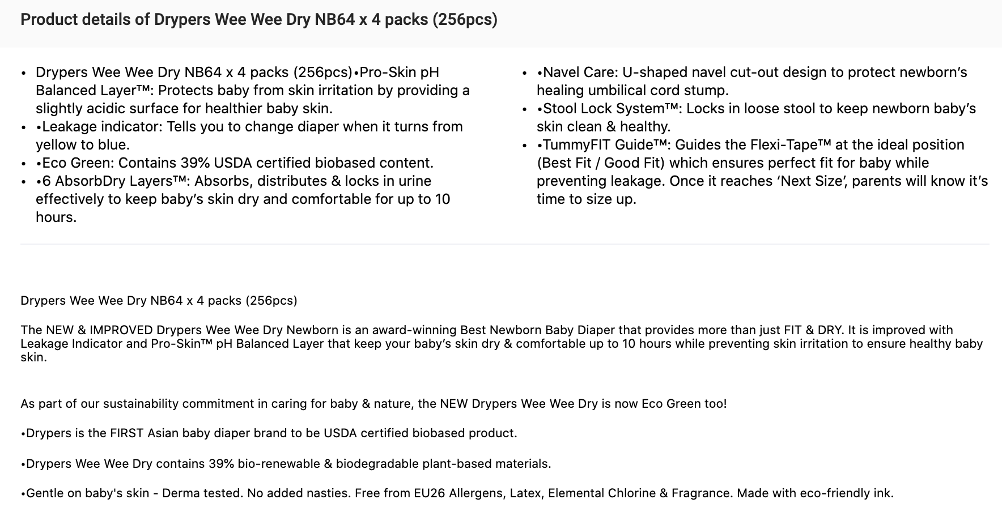
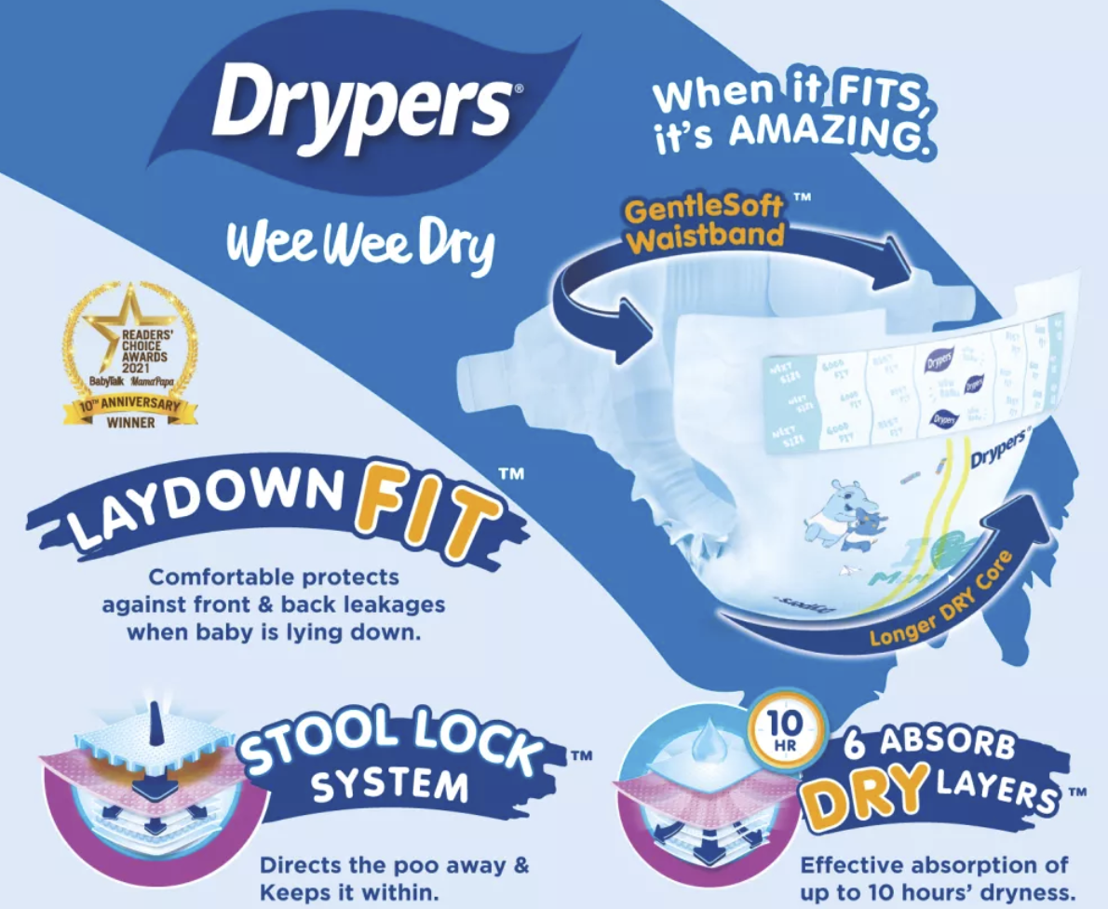
CONSENSYS
SELLER METRICS
Capture
PRODUCT DETAILS FULL TEXT
ANY MARKETING IMAGES
Consensys.world
© CONSENSYS

Slide 6
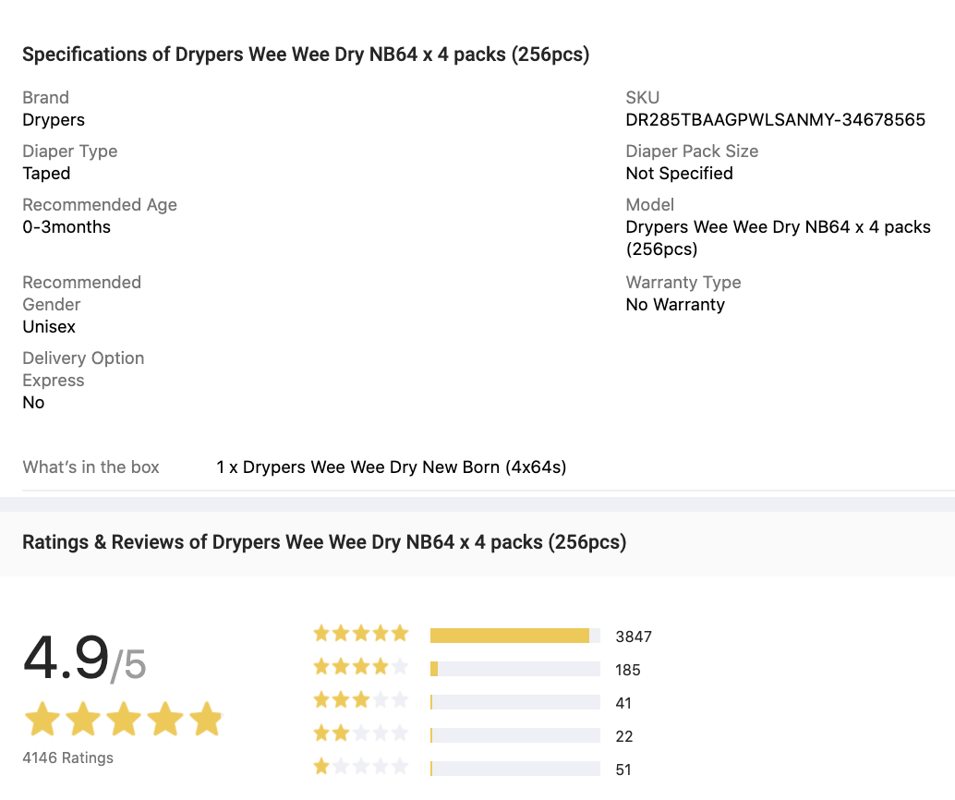
CONSENSYS
Capture
Consensys.world
© CONSENSYS

Slide 7
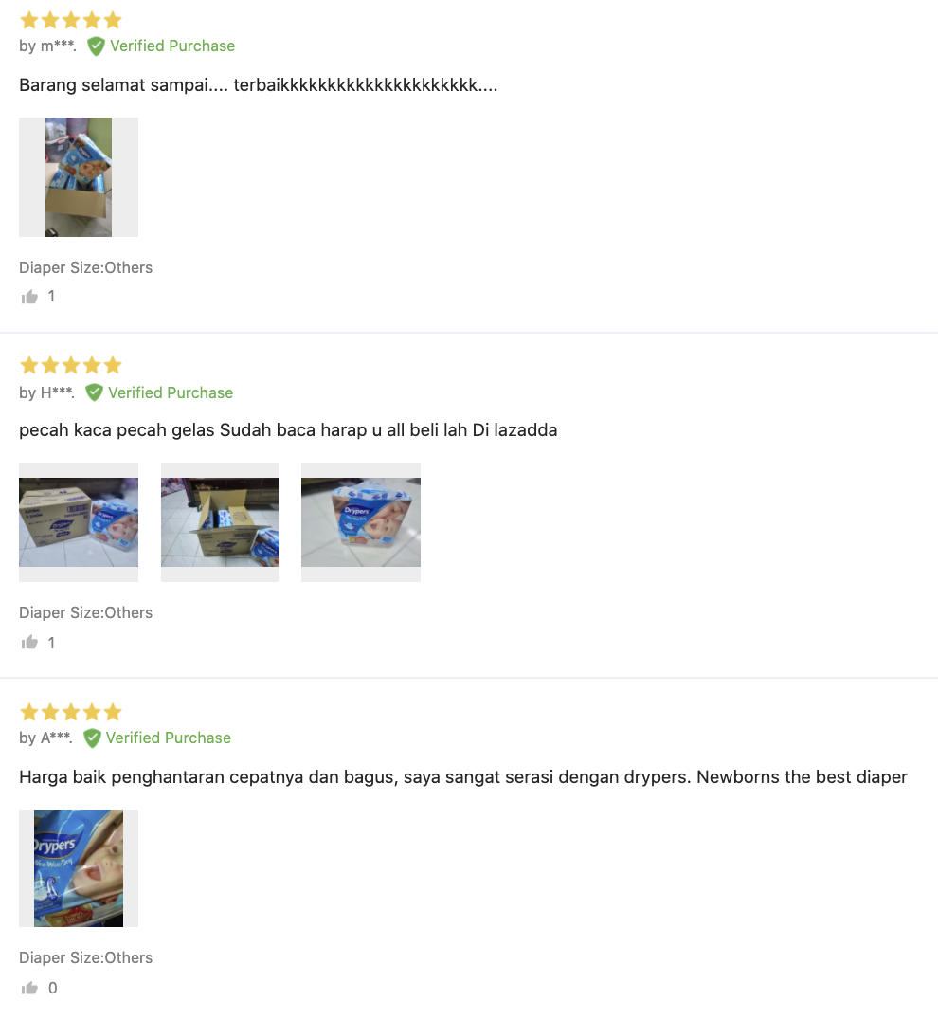
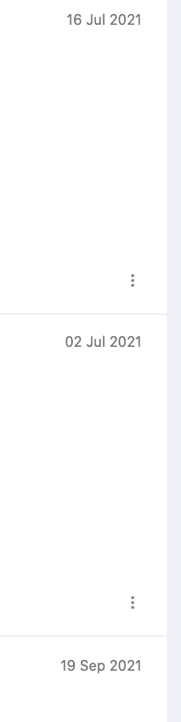
CONSENSYS
TEXT ORIGINAL AND A VERY GOOD TRANSLATION TO ENGLISH
ALL REVIEWS
Capture
Consensys.world
© CONSENSYS

